Slide 1

Git 101
by Aryan Sisodia

Slide 2
What is Git?
Git is a distributed version control system
That basically means...
It's a system that records changes to our files over time
We can recall any specific versions of those files at any given time
Many people can easily collaborate on a project and have their own version of project files on their computer

Slide 3
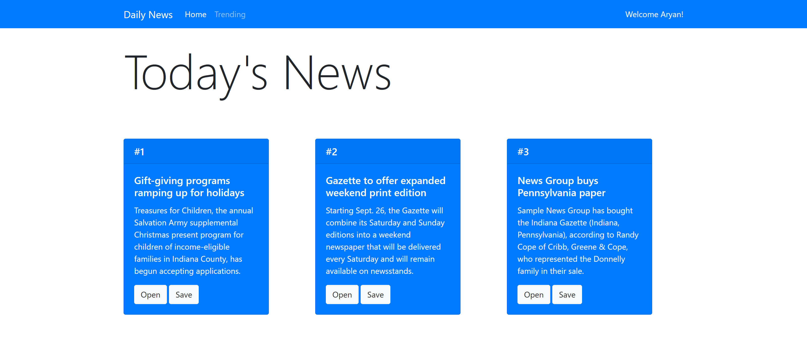
Why use Git?

Slide 4
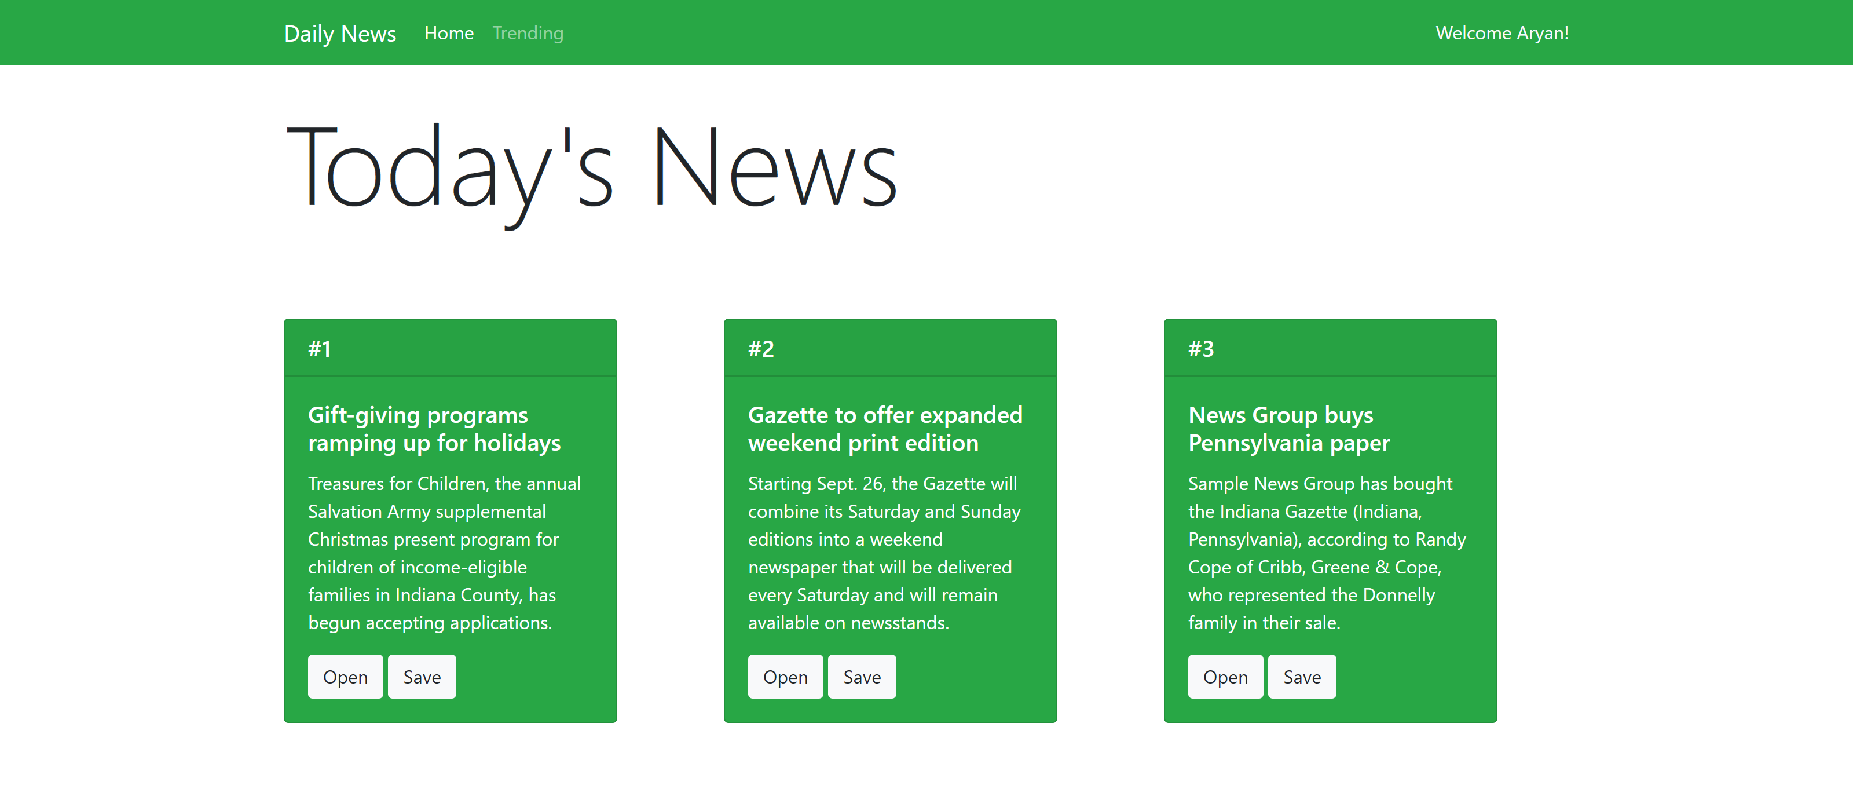
Why use Git?

Slide 5

Why use Git?

Slide 6

Store revision in a project history in just one directory
Rewind to any revision in the project I wanted to
Work on new features without messing up the main codebase
Easily collaborate with other programmers
Notes:
git config --global user.name aryansisodia
git config --global user.email aryansisodia@outlook.com
git config user.name

Slide 7
Repositories (Repos)
A repo is a container for a project you want to track with git (like a web project)
Can have many different repo's for many different projects on your computer
It’s like a project folder which git tracks the contents of for us
Notes:
git init
git status

Slide 8
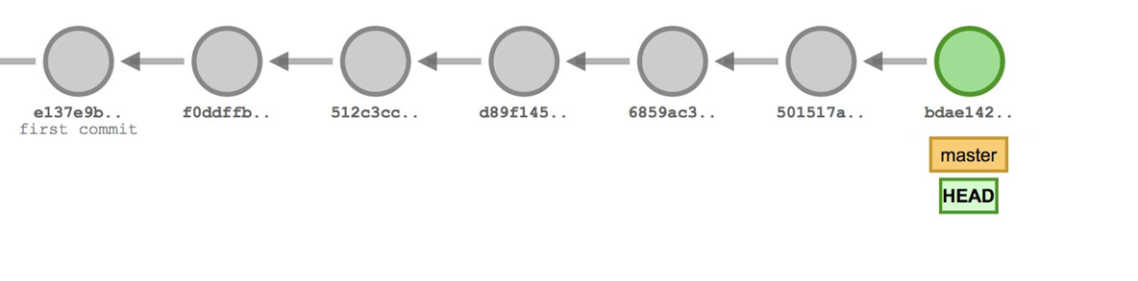
Commits
Create boilerplate code
Install essential libraries
Complete first module
Add image & stylesheet assets
Fix header title bug
Remove redundant assets
Add ML lib
Notes:
Checkpoint
Saves snapshot of our code

Slide 9
Commits – Staging Steps
Modified
Changed files. Not committed.
Staging
Add any changed files to staging that you want to commit.
Committed
Any files in the staging area are added to the commit when we make one
Notes:
git add filename
git rm --cached filename
git add .
git commit -m "some message"

Slide 10
Undoing Things
Checkout Commit
Changed files. Not committed.
Revert Commit
Add any changed files to staging that you want to commit.
Reset Commit
Any files in the staging area are added to the commit when we make one
Notes:
git checkout hash
git checkout master
CHECK THIS!!!! (SHIFT + COLON -> wq)
git revert hash
git reset hash
git reset hash --hard

Slide 11
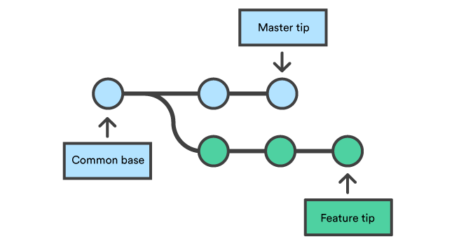
Branches
Notes:
git branch new_branch_name
git branch -a
git checkout branch_name
(go to master first)
git branch -d branch_name
git branch -D branch_name
git checkout -b new_branch_name

Slide 12
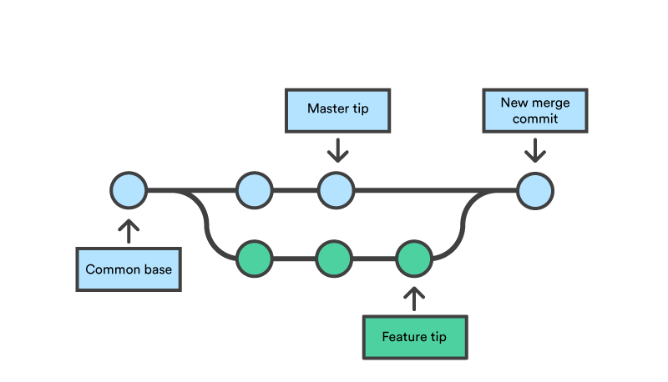
Branches - Merging
Notes:
(go to master first)
git merge branch_name
(if conflict -> fix file)
git add .
git commit

Slide 13

GitHub is an online git repository hosting service
That basically means…
It’s an online service that lets us set up hosted repositories.
Share our code with other developers
Developers can download the projects and work on them
They can re-upload their edits and merge them with the main codebase.

Slide 14
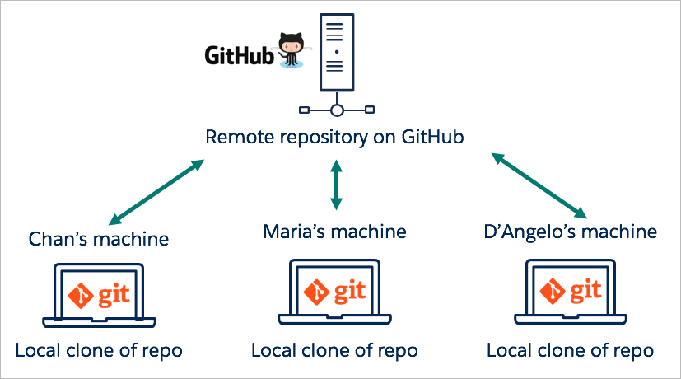

Slide 15
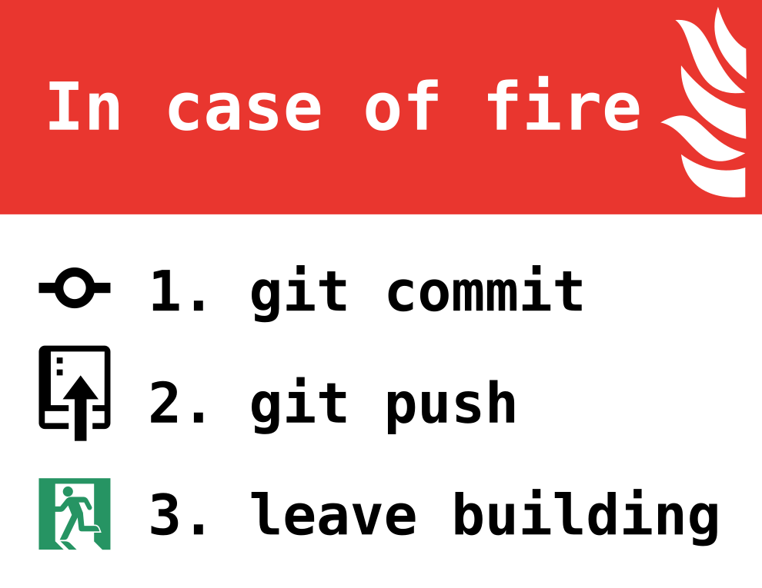
Thank You! Any questions?

